Slide 1
Modern IND Safety Reporting Accurate reporting without wasted effort
Best Practices for Sites and Monitors
Steven Beales
WCG Clinical
Notes:
Thank you all for coming here today. Only the best people in any field, the top 10%, take the time to travel so far for a conference like this. Oh and also those who only go to 1 conference per year and pick the one in Las Vegas.
You’re going to enjoy the time we spend together this morning. I will share with you some of the most important practices that have been discovered in Global Safety Reporting from a site and monitoring perspective and enable you to be more productive without sacrificing safety.
I’ve been fortunate enough in my career to work alongside the top 1 pharma by revenue in US, EU, and Japan and top 1 CRO in world on expedited safety reporting.
These companies would be sending out over 50m safety letters per year to sites if they were doing things the old way and spending millions of hours verifying that every investigator had read every safety report.

Slide 2

Speaker Introduction
Steven Beales
Current SVP, Scientific and Regulatory for WCG Clinical
Co-chair Safety Reporting Harmonization Working Group
Led design and implementation of Safety Reporting Portals at Roche, Janssen, Covance, and many others.
25+ Years Experience in Pharma IT Industry including 8 years at Johns Hopkins.
Contact
610-834-6209
sbeales@wcgclinical.com
@stevenbeales
https://linkedin.com/in/stevenbeales
Notes:
I’m Steven Beales, SVP, Scientific and Regulatory for WCG Clinical. I’ve been with WCG for over 10 years but before that I spent 8 years working at John Hopkins Sidney Kimmel Comprehensive Cancer Center so I tend to look at most problems from the sponsor and site perspective simultaneously and I appreciate that there are good and bad people on both sides.
Apologies, if you struggle to understand my accent. I’ve spent half my life in the UK and half in the US. Every day I wake up not knowing which government is going to embarrass me more. This month, it’s been too close to call.

Slide 3
Site Agenda
Top 5 Site Problems
Regulatory Obligations
Site Burden
Things To Know
Technology
Notes:
WCG conducted a survey of our site network before this conference and I’ll be sharing with you – a world premiere - the top 5 safety reporting problems reported by sites.
Then we’ll discuss what sites are required to do according to FDA guidance and the burden that places on sites.
We’ll follow up with some Safety Reporting Terminology and compliance tips including the 1 thing we want you to remember from this talk.
And lastly we’ll look at how technology and tools can help you.
Sound good?

Slide 4



Top 5 Site Problems
Too Many Reports
Duplicate Reports
Overly Time-consuming
Too Many Websites
Useful Information Hidden
Notes:
The top 5 site problems are 1.Too Many Reports. 2. Too Many Duplicate Reports. 3. Processing reports is too time consuming. 4. There are too many different websites from different sponsors and too many usernames and passwords. 5. Sites are drowning in information, not wisdom. Can’t see the crucial safety signals for all the unimportant information.
Why are these problems happening? Sites are overwhelmed with over-reported and cross-reported safety reports due to “brute-force” distribution. Many companies distribute all safety reports to all Sites and Ethics Committees instead of observing local safety reporting laws. This is not what the Regulatory Agencies want or intended to happen.
We have a failed system. So how can we fix it?

Slide 5
Too Many Reports
More THAN 20 PER MONTH
AVERAGE PER QUARTER
REFUSED TO PROCESS
80%
170
20%
Number of Safety Reports
Number of Sites
Notes:
Why do sites get too many reports?
80% of sites receive more than 20 SUSARs per month.
20% have refused to process a SUSAR because it was an over-distribution – a Safety Report that did not qualify as an unanticipated problem and did not need to be submitted to the IRB. Most IRBs, including WCGs, will acknowledge Safety Reports if your sponsor says you must submit every Safety Report but will not review them unless they qualify as an unanticipated problem. Push back on Expedited Safety Reports that should not be expedited.
The most common complaint from sites on our Safety Reporting site survey - “Why can’t sponsors get their act together and stop sending us SUSARs where there is no causal relationship to the drug?” The FDA estimated 86% of SUSARs on 1 oncology trial did not qualify for expedited reporting.
Average PI receives 170 safety letters on average per quarter. Median PI receives 85 per quarter.

Slide 6
Duplicate Reports
per Study COORDINATOR
ON SAME COMPOUND
PER COMPOUND
7
17.5
3.1
Average Number of Trials
Notes:
Why do we get so many duplicate IND safety reports? Because a suspected unexpected serious adverse reaction that occurs on 1 trial needs to be cross-reported to all trials using that IND or compound.
Safety Reporting is a compound level activity not a study level activity. It is important to organize your staff at Compound level to optimize yourselves for this activity and filter the duplicates yourselves. Each site is typically working at least 3 studies on same IND so you are forcing your PIs to see reports in triplicate if you don’t do this triage. Each coordinator is working on up to 7 studies at a time so try to minimize the amount of different compounds they need to manage.
There are an average of 17.5 studies per compound including Investigator initiated trials and comparator studies etc.

Slide 7
Overly Time-Consuming
15 minutes
2 HOURS
44$
time to monitor
SAFETY REPORT
TOTAL TIME
PER SAFETY REPORT
TOTAL SITE COST PER SAFETY REPORT
Notes:
Each safety report takes an average of 15 minutes to triage and up to 2 hours total time per SUSAR to process including workflow, archiving and monitoring.
Average cost to a site for all these activities is $44 per safety report and 340 hours of staff time per quarter.

Slide 8




Useful Information Hidden
40000+ INDSRs reviewed by
Tennessee Oncology PIs
FAX
Emails
Filtered for Duplicates
4000+ AVG INDSRs reviewed per PI
20+ AVG INDSRs reviewed per compound
Portals
Mail
200+ Different Compounds
MAGI's Clinical Research Conference
8
Notes:
This data is taken from Tennessee Oncology who I worked with in Nashville over 10 years ago.
Despite reviewing over 40k+ IND Safety Reports, 0 had resulted in a change to clinical practice or how they treated the patient. Useful safety information came but usually as Dear Investigator Letters or some other kind of urgent safety communication.

Slide 9







Too Many Websites
Site Friendly Safety Portal
Top 1 US Pharma
Top 3 US Biotech
Top 1 EU Pharma
Top 1 US CRO
Top 1 Japan Pharma
Top 1 US IRB
(Not TransCelerate)
Notes:
Too many websites is out of sites control mostly since this is often dictated by Sponsors and CROs.
What’s interesting is that Roche, Janssen, Covance and Celgene have all standardized on same Site Friendly technology for Safety Reporting to Sites and it implements all the practices we will be talking about today to reduce the burden on sites. This is a promising change.
And it’s not TransCelerate.

Slide 10

Understand Regulatory Obligations
Notes:
Let’s talk about the FDA’s 2012 and 2015 guidance to Safety Reporting.

Slide 11


Goals of IND Safety Reporting
YES | NO
Safety | Reporting
Quality | Quantity
Meaningful | Meaningless
Actionable | Too many reports
Patient Care | Checking Boxes
Information | Obfuscation
Unified | Too many systems
Notes:
The words on the left are the spirit of how to conduct IND Safety Reporting. The words on the right are what too many people do and they say “We have to do this. It’s compliance or similar excuse for not changing.”

Slide 12
Reporting to IRBs and IECs
Only Report Unanticipated Problems
Expedited Reports SHOULD be Unanticipated Problems
Not all Unanticipated Problems are SAEs
Patient Risk/Benefit Ratio
5 day or 10 day timelines
Notes:
An unanticipated problem is both unexpected and unanticipated. I will define these terms for you later since somehow we have managed to have FDA guidance that defines unanticipated events that are not unexpected events or unanticipated problems – which is about as confusing as you can make legislation.
What makes our IRB colleagues so upset is receiving expedited safety reports that are not unanticipated problems.

Slide 13
Does the PI at Your Site Review?
9%
17%
61%
13%
Protocol or consent changes
URGENT OR LIFE-threatening
ALL SAFETY REPORTS
AD-HOC
Notes:
The PI does not have to review every safety report. Your SOPs probably say otherwise. The PI does have to be aware of the latest safety information and understand the risk/benefit profile of the drug but that is not same thing as reading every safety report, which can be delegated to a qualified safety responsible.
Important that you think about and optimize processes at your sites not just check boxes.

Slide 14

Who Reviews Before the PI?
Study Coordinator/CRC
42.41%
Regulatory Coordinator
48.66%
Compliance Officer
1.79%
Other Investigator
1.79%
None
5.36%
0%
25%
50%
75%
100%
Notes:
This is a breakdown of who reviews Safety information at Sites. In 95% of cases, the PI is not the first person to review a Safety Report at a site. Many sponsors will verify that someone at your site has viewed the Safety Report but leave it to your internal site SOPs to ensure the PI sees any safety information that changes the risk/benefit ratio of the drug.

Slide 15

Site Burden
Notes:
Let’s look at the ever increasing burden on sites. Blockbuster oncology products like PD-1 inhibitors have increased the volume of safety reports by 500%.

Slide 16
Site Resource Statistics
1
1
61% SITES > 80 hours/month staff time
Including triage, review, forwarding, archiving and monitoring
2
2
$22 - ACTUAL SITE COSTS PER REPORT
Range from $17-$39, not including monitoring and annual archiving costs
3
3
$45 – AVERAGE SITE BUDGET PER REPORT
51% Gross Margin per Safety Report
Notes:
61% sites spend more than 80% of staff time on processing IND Safety Reports.
The average cost per safety report in labor was $22 not including any additional costs.
The average budgeted cost was $45 – so 1 bonus is that sites can generate revenue by reading unnecessary safety reports at cost of not spending time with patients.

Slide 17
Number of Safety Reports by Compound
Notes:
17
This is annual data from a top 5 pharma. Over 11k Safety Reports per year.
This is stunning. 28% Of SUSARs from 1 oncology compound. 40% from top 2 compounds. 55% from top 8 compounds. 45% from other 121 compounds.
Except for the people who are working directly in Safety Reporting, no one else understands how incredible the volume of Safety Reports has become.

Slide 18
What Would Sites Prefer?
Aggregate line listings
Periodic summaries of SAEs
Data Monitoring Committee reports
Aggregate data
Notification letters of unanticipated problems
Summarized data
Notes:
What sites said was useful …
This is how EMA would like Safety Information to be sent. This is how FDA envisages Safety Information is sent if causality assessments were done properly.

Slide 19
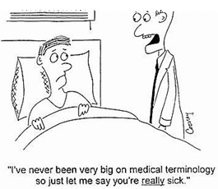
Things To Know

Slide 20

If you only remember one thing today …
Anticipated Events and Expected Events
are NOT the same

Slide 21
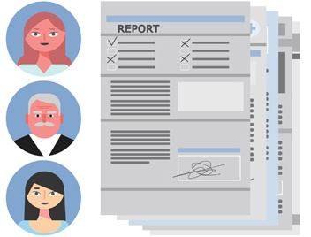
What is a Serious Anticipated Event?
Focus is Target Population
Listed in Protocol
Safety Surveillance Plan
May not be reportable
Requires Aggregate Analysis
Notes:
Safety Management Plan

Slide 22
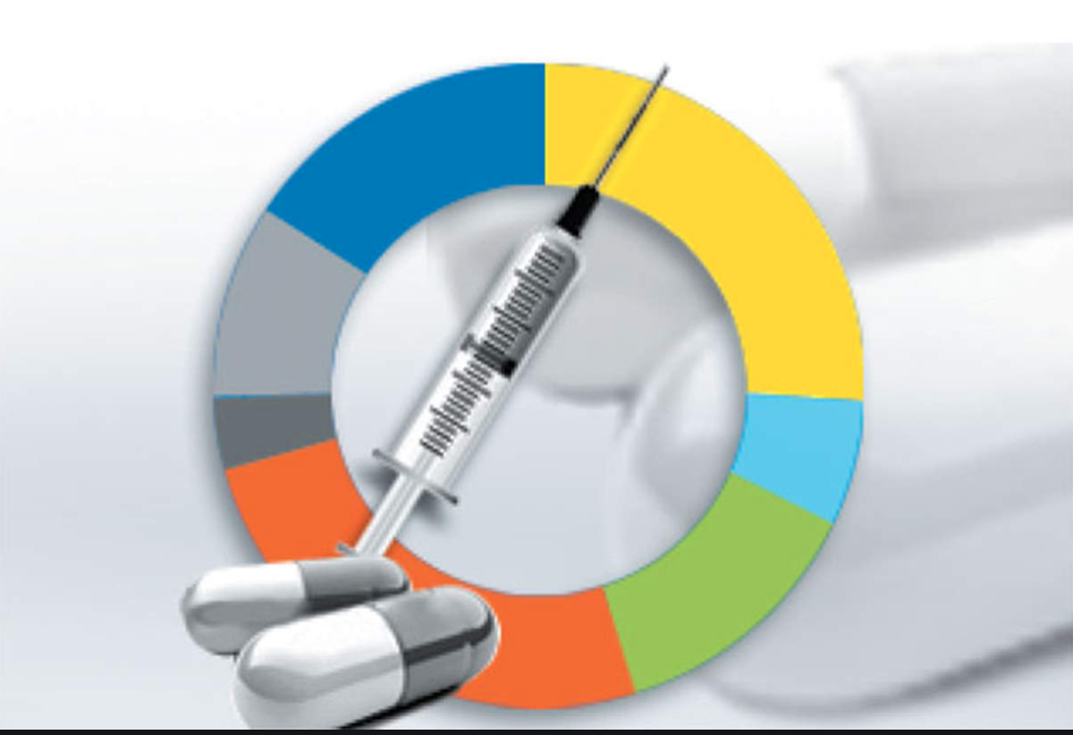
What is a Serious Adverse Event?
Focus is Investigational Medicinal Product
Investigator’s Brochure
Seriousness
Relatedness
Expectedness
Notes:
Seriousness is a measure of outcome (hospitalization or greater). Severity is a measure of intensity. Things can be severe but not serious.
Expectedness is measured against the IB not the protocol.

Slide 23

Use Technology

Slide 24
Technology Recommendations
01
02
03
Easy Acknowledgement No Signatures
Batch Notifications
Delegation
1-Click
Per Site User’s Preferences
To Site Staff via Delegation Log
04
05
06
Compound Level
Audit Trail
Offline Delivery
Acknowledgement per Compound not per Trial
Printable/Saveable
End to End Audit Trail
Multiple methods of delivery and access
Notes:
This is what to expect from latest Safety Reporting Technology. If your Sponsor or CRO’s technology can’t do all of the above, then they are slowing you down and not providing you with the best technology.

Slide 25

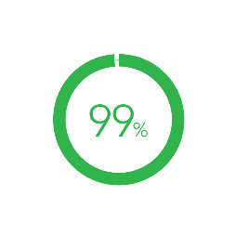
Effect of Technology
Costs
Avoided
Sites in Compliance
Reduction in Site Burden
175 - 450k
per trial
10 hours
per week
Notes:
These are statistics from the 4 sponsors and CROs mentioned earlier.
Some initial results include 175k vs basic technology and 450k vs manual distribution.
99% of sites have trained active users in system and receiving delivery.
Average reduction in Safety Reports per week = 5 resulting in 10 hours saved per site per week.

Slide 26



When Sponsors Get It Right
Site Experience and Testimonials
“System is seriously phenomenal compared to other sponsor’s pharmacovigilance systems”
Columbia University

Slide 27


Best Practice Tips for Sites
Delegate Safety Responsible other than PI to triage Reports
Budget Sufficient Hours for Training, Reading, Filing Safety Reports
Don’t print out and sign every Safety Report. Use technology
Know what to expect for safety reporting. Understand the regulations. Push back on Sponsors doing it wrong
Organize processes at a Compound (IND) level, not at a trial level

Slide 28

Ask Big Questions
MAGI's Clinical Research Conference
28

Slide 29
Monitoring Agenda
If this is modern, what was old?
Where Safety belongs
Safety Reporting Basics
5 Best Practices
Summary

Slide 30
A look back in time…
A journey in safety reporting……
You’ve got mail!
Put it in a portal
Industry issue
Rules and Regulations
Process and System alignment
You’ve got email!
Early days!
2006
2019 and Beyond!
2010
Email for sending documents!
2017

Slide 31
Safety Interdependencies
Safety management impacts and influences key phases in clinical development
Approved Protocol
Approval Process
Patient Recruitment
Data Entry and Review
Statistical Analysis
Presentation and publications of results
Investigator Selection
Filing and registration
Notes:
Safety Management is a process that starts prior to a clinical trial commencing and continues throughout its lifecycle and beyond

Slide 32
Safety Reporting Basics
Data Collection
Sponsor
Safety Reporting
Stakeholders
GCP/Regulatory Requirements
Protocol
Data Collection Process & Systems
Timelines
AEs vs SAEs
Training
Investigator Responsibilities
Medical Review
Analysis & trends
Risk benefit profile
Reference Safety Information
Safety Database
Spontaneous reports
Monitoring and literature searches
…..
GCP/Regulatory Requirements
Document Formats and standards
Aggregate vs Individual case reporting
Marketing status
Annual Updates
Expedited vs Non-Expedited
Investigator Brochures
Clinical Study Reports
DSURs
Commercia Information
SUSARs/INDSRs
Aggregate Reports
DIL/USM

Slide 33
Best Practice Tips
Tip 1 – Ask what information your sites are accountable to report, in an expedited fashion
Tip 2 - Ask how information is shared at your sites
Tip 3 – Ask how information is shared within your company for your study
Tip 4 – Know what to expect for safety reporting
Tip 5 – Timeliness is key for reporting
Notes:
Separate slide per BP

Slide 34
Summary
Things to do differently….
Know who does what and what you are accountable for
Know what safety information is produced within your organization to comply to local law
Safety reporting is a compound level activity (not a study)
A process cannot be operationalized without the tools and technology to make it work
Safety report monitoring is not counting clicks on links or signatures

Slide 35
Ask Big Questions
MAGI's Clinical Research Conference
35

